Slide 1
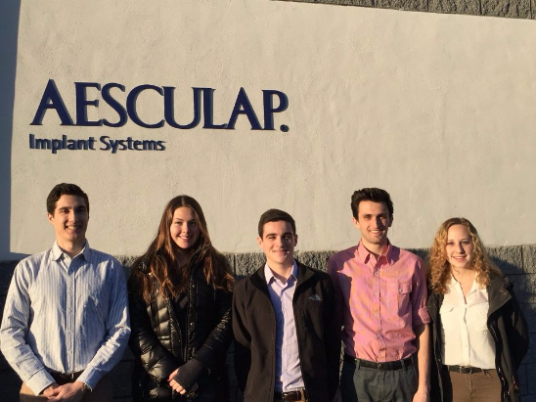
Aesculap 1
Cassie Obzud • Brian Loughran • Cassie Christman
Jadon Sargeant • Christian Davis • Alexis Haupt

Slide 2
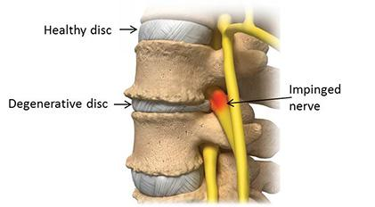
Industry Overview
Chronic lower back pain in adults
Degenerative Disc Disease
30% of people age 30-50
Physical therapy, steroid injections, surgical correction
600,000 spinal surgeries per year
Cassie Obzud

Slide 3


Aesculap
Leading medical device company
Innovation, efficiency, sustainability
Research
Cassie Obzud

Slide 4

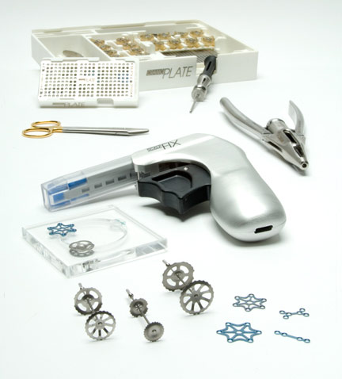
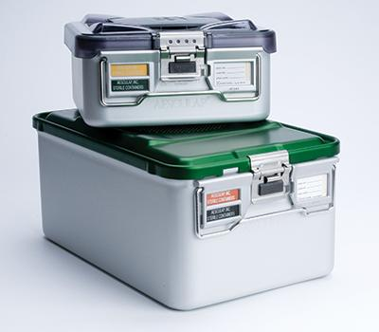
Aesculap
Neurosurgery
Surgical Technologies
Closure Technologies
Orthopaedics
Spine Biologics
Cassie Obzud

Slide 5
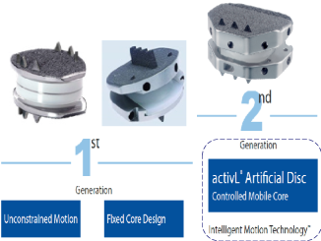
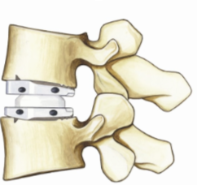
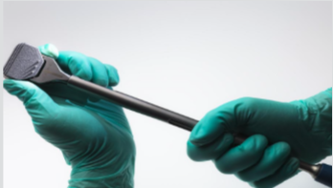
ActivL
ActivL Artificial Disc
First lumbar disc to be approved in 10 years
Closest mirror to healthy human spine
Stability & single step insertion
Next generation motion preservation opportunity
Cassie Obzud

Slide 6
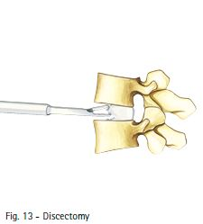
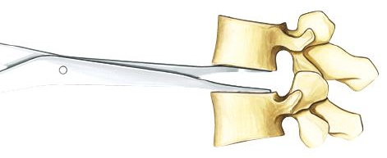
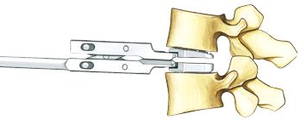
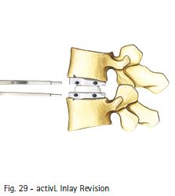
Surgical Procedure
Images courtesy of Aesculap

Slide 7
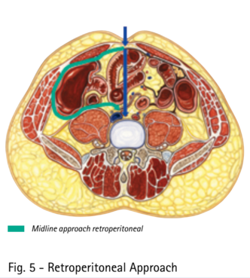
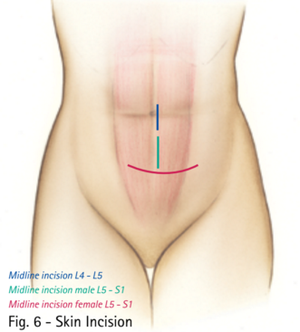
Our Project
Current methods: rigid/angled distractors
Stress concentrations
Need for better distracting instrument
Parallel Distraction of the spine
Brian Loughran
Images courtesy of Aesculap

Slide 8
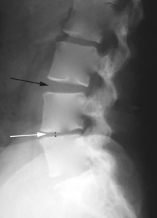
Mission Statement
Our mission is to provide a parallel distractor to be used by orthopedic surgeons in an effort to increase quality of life for patients with severe degenerative disk disease in the spine.
Brian Loughran
http://treatbackpainnaturally.com/degenerative-disc-disease-2

Slide 9

Customer and End User
Customer: Hospitals and Insurance Companies
End Users: Orthopaedic surgeons and Neurosurgeons
In communication with local surgical offices
Cassie Christman
Notes:
· The customers and end users for our product are two different sets of individuals. The customers are hospitals and insurance companies; whereas the end users will be primarily orthopaedic surgeons and neurosurgeons.
· The research conducted in order to determine the customer and end user needs was done by Aesculap, but we are also in communication with local surgical offices to establish any other additional needs.

Slide 10

Customer Needs
Financial need: appropriate cost as to not increase current price of $207.92
Fit:
42 CFR 482.42(a): infection control
cleanable and sterilizable for steam sterilization and IUSS
ISO 7153-1: standard medical grade materials
Cassie Christman
Notes:
· From the standpoint of the hospitals and insurance companies, the cost to manufacture of the distractor is obviously an important parameter to consider. The current production cost of the distractor is $207.92, therefore, our device needs to be producible at a lower cost to attract customers to our product.
· Additionally, hospitals must comply with regulation 42 CFR 482.42(a) set by the Department of Health and Human Services with regards to infection control. Therefore, our distractor will be cleanable and sterilizable for both steam sterilization and IUSS sterilization. This will go hand-in-hand with ISO standard 7153-1 with the distractor being made of standard medical grade material.
Aesculap expressed to us that although the hospitals and insurance companies' input of the distractor are important, we should focus heavily on the needs of the surgeons

Slide 11
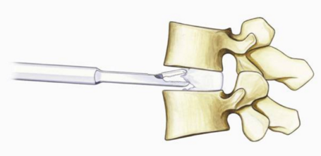
End User
Form:
narrow profile
interchangeable paddles
quick connect system
Function:
ratchet system
Feature:
paddle reset
impaction handle
Cassie Christman
Notes:
· As previously stated, orthopaedic surgeons and neurosurgeons use the distractor after removing a small portion of the degenerated disc to prevent the spine from collapsing while he removes the remnants of the damaged tissue.
· Because the surgeon needs to remove all of this tissue before inserting the replacement disc, maximizing the visualization of the surgical site is crucial, and therefore, our distractor will have a narrow profile.
· This narrow profile will depend largely on the size of the paddles of the distractor. In order for the surgeon to have maximum view of the surgical site and be able to customize the device for a particular patient, the distractor will have interchangeable paddles, with those paddles attaching to the instrument through a quick connect system which will also improve the efficiency of the procedure.
· Once the distractor is inserted between the vertebrae, the surgeon needs to focus on removing the remaining pieces of the degenerated disc; however, in order to maintain the vertebrae distraction, the surgeon would need to apply constant force to the distractor. Thus, our distractor will have a ratchet system to maintain this distraction force without continuous input from the surgeon so he can focus on the actual surgical procedure.
· Once the surgeon finishes removing the rest of the degenerated disc, he needs to remove the distractor and measure the distance between the vertebrae to select the proper activL height implant. Although the spine can maintain this distraction for several minutes, quick removal of the distractor is essential for the surgeon to have sufficient time to insert the activL device; therefore, our distractor will have a spring that resets the paddles upon the release of the instrument handles.
· An additional feature we believe will be beneficial to surgeons, is an easily removable impaction handle. Often times surgeons have difficulty initially inserting the distractor and must hammer it into the proper location. However, this can be detrimental to both the patient and the distractor. Thus, our distractor will have an impaction handle as a safe method to insert the distractor and it will be easily removable from the distractor to maximize the surgeon's visual of the surgical site while performing the procedure.
These customer and end users needs will help us determine the target specifications for our distractor, which Jadon will now elaborate on.

Slide 12
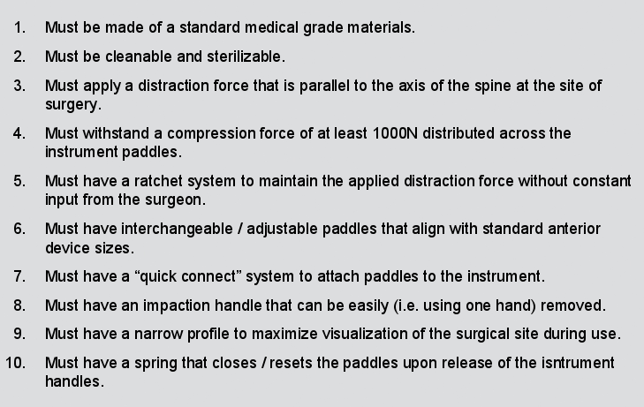
Target Specifications: Metrics and Target Values
Jadon Sargeant

Slide 13
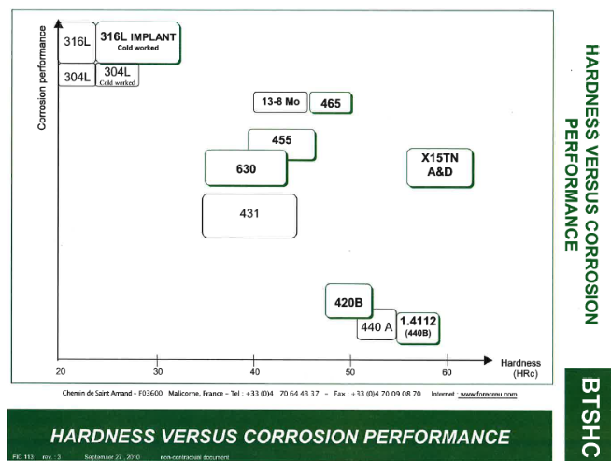
Summary of Considerations - Material
Biosafety
Corrosion resistant
Sterilizable / Autoclavable
Low deformation even under cyclic loading
Cost effective
Weight
Ti gr-23
Ti 6Al-4V
Jadon Sargeant

Slide 14
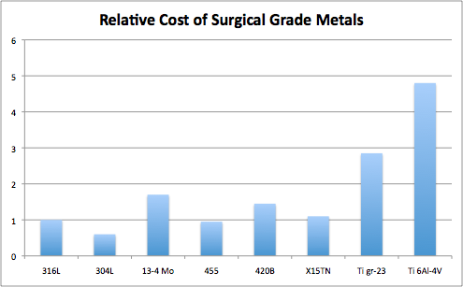
Good Options
http://hghouston.com/resources/material-property-data/stainless-steel-data/stainless-steel-cost-data

Slide 15
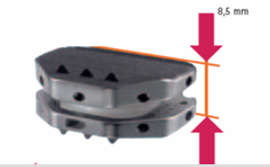
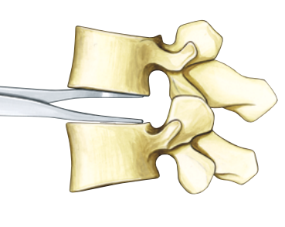
Numerical Requirements
8.5mm - 14mm
1000N compression distributed across the instrument paddles
Greater than 14mm parallel displacement
Cyclic loading number of cycles to be determined based off ASME and ASTM standards
1000N
Jadon Sargeant

Slide 16
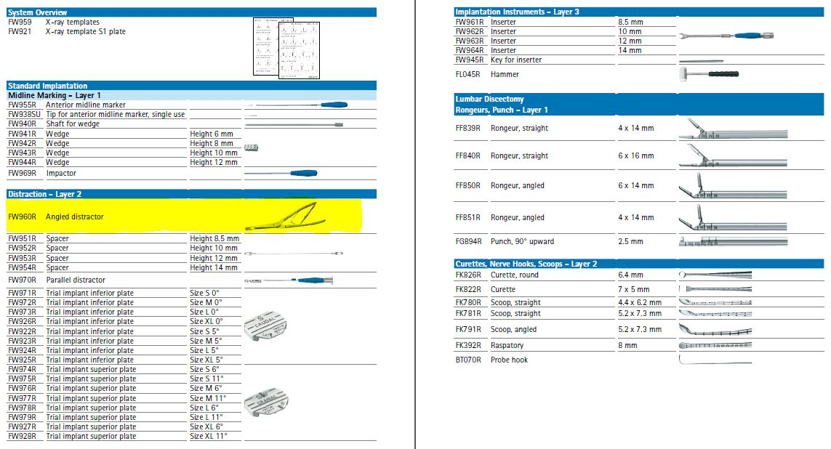
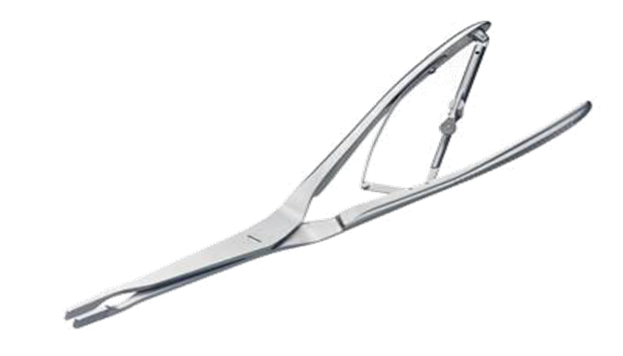
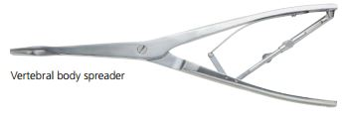
Competitive Benchmarks
Distractor comes as part of package
ActivL implant is accompanied by 25+ surgical tools
Only implant competitor is DePuy Synthes
ProDisc-L implant
Other distractors exist, but are not competitors
Explored through patent analysis
Christian Davis
DePuy Synthes
Aesculap
http://www.synthes.com/MediaBin/US%20DATA/Product%20Support%20Materials/Technique%20Guides/SPTGAntLumIntbdyFusJ3544C.pdf
Images courtesy of Aesculap

Slide 17
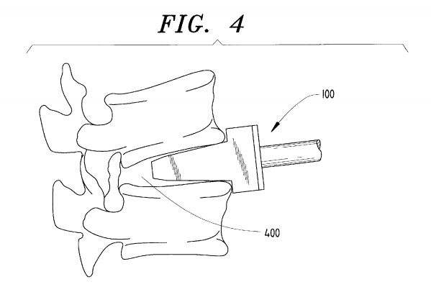
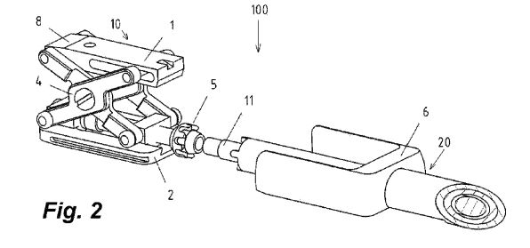
Intellectual Property
Wedge Style Distractor
Developed list of 19 relevant patents
Wedge
Parallel Crossbar
Scissor
Hinged
Tapered Blade
Scissor Style Distractor
US Pat. #6,224,599
Christian Davis
US Pat. #8,277,456

Slide 18



Standards
US Food and Drug Administration (FDA)
Quality Systems Regulation for Medical Devices
Provided by Aesculap
International Organization for Standardization (ISO)
ISO 7151:1988 - Surgical Instruments, Non-cutting
ISO 7153-1:1991 - Surgical Instruments, Metallic Materials, Part 1: Stainless Steel
ISO/DIS 7153-1 - Surgical Instruments, Materials, Part 1: Metals
Available through Aesculap and Lehigh
American Society of Mechanical Engineers (ASME)
Standardized mechanical tests
Available through Aesculap
Christian Davis
http://www.iso.org/iso/home/store/catalogue_ics/catalogue_ics_browse.htm?ICS1=11&ICS2=40&ICS3=30

Slide 19
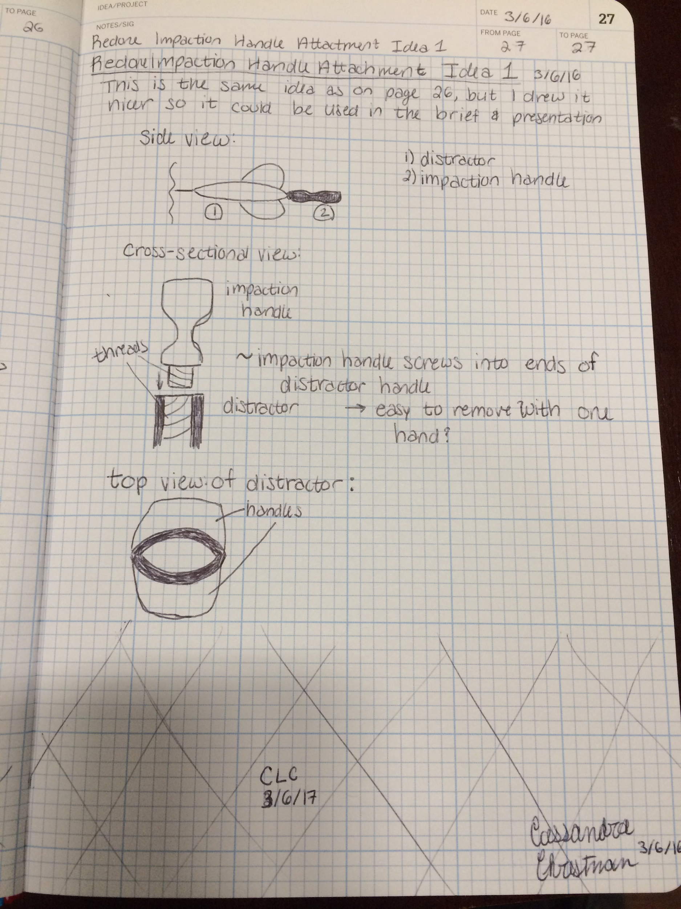
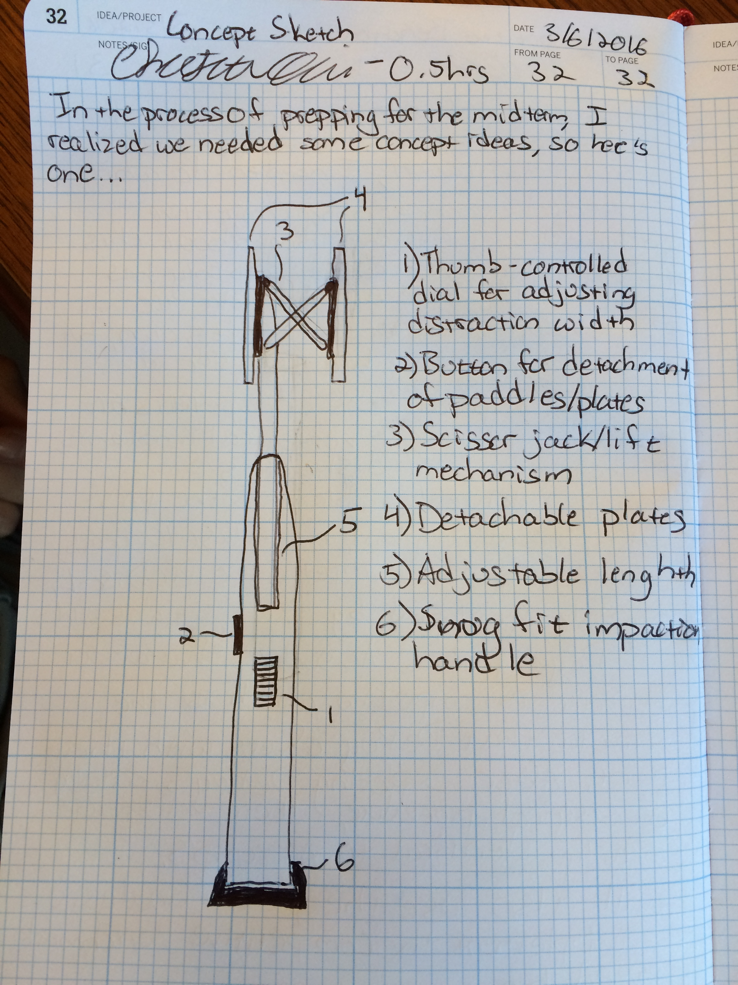
Prototyping - Sketches
Christian Davis

Slide 20

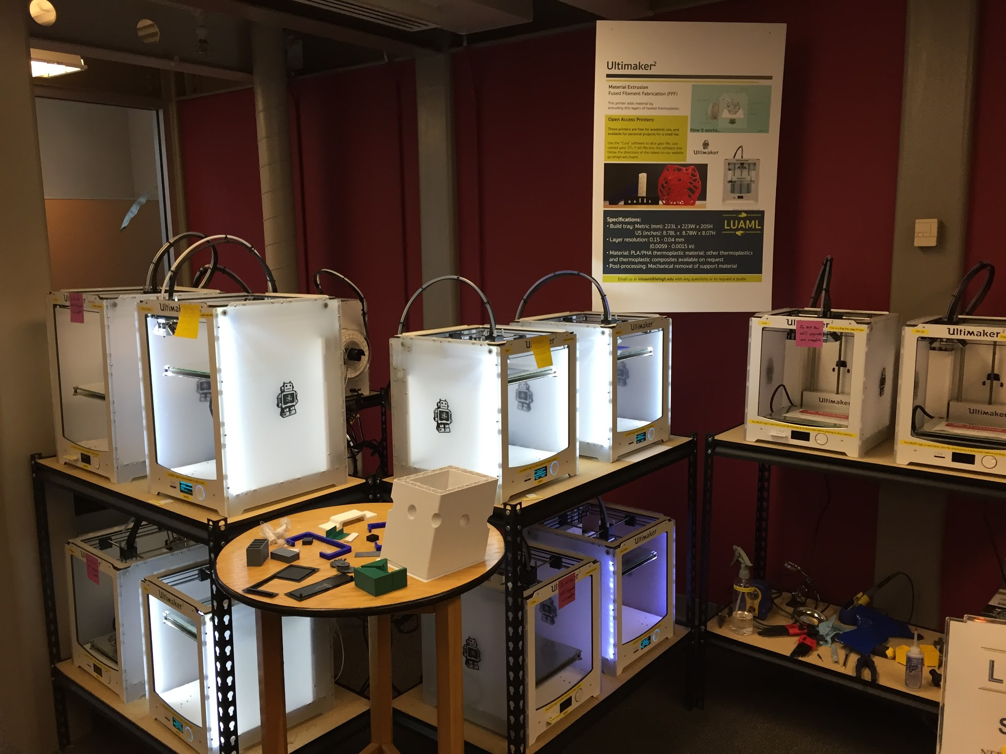
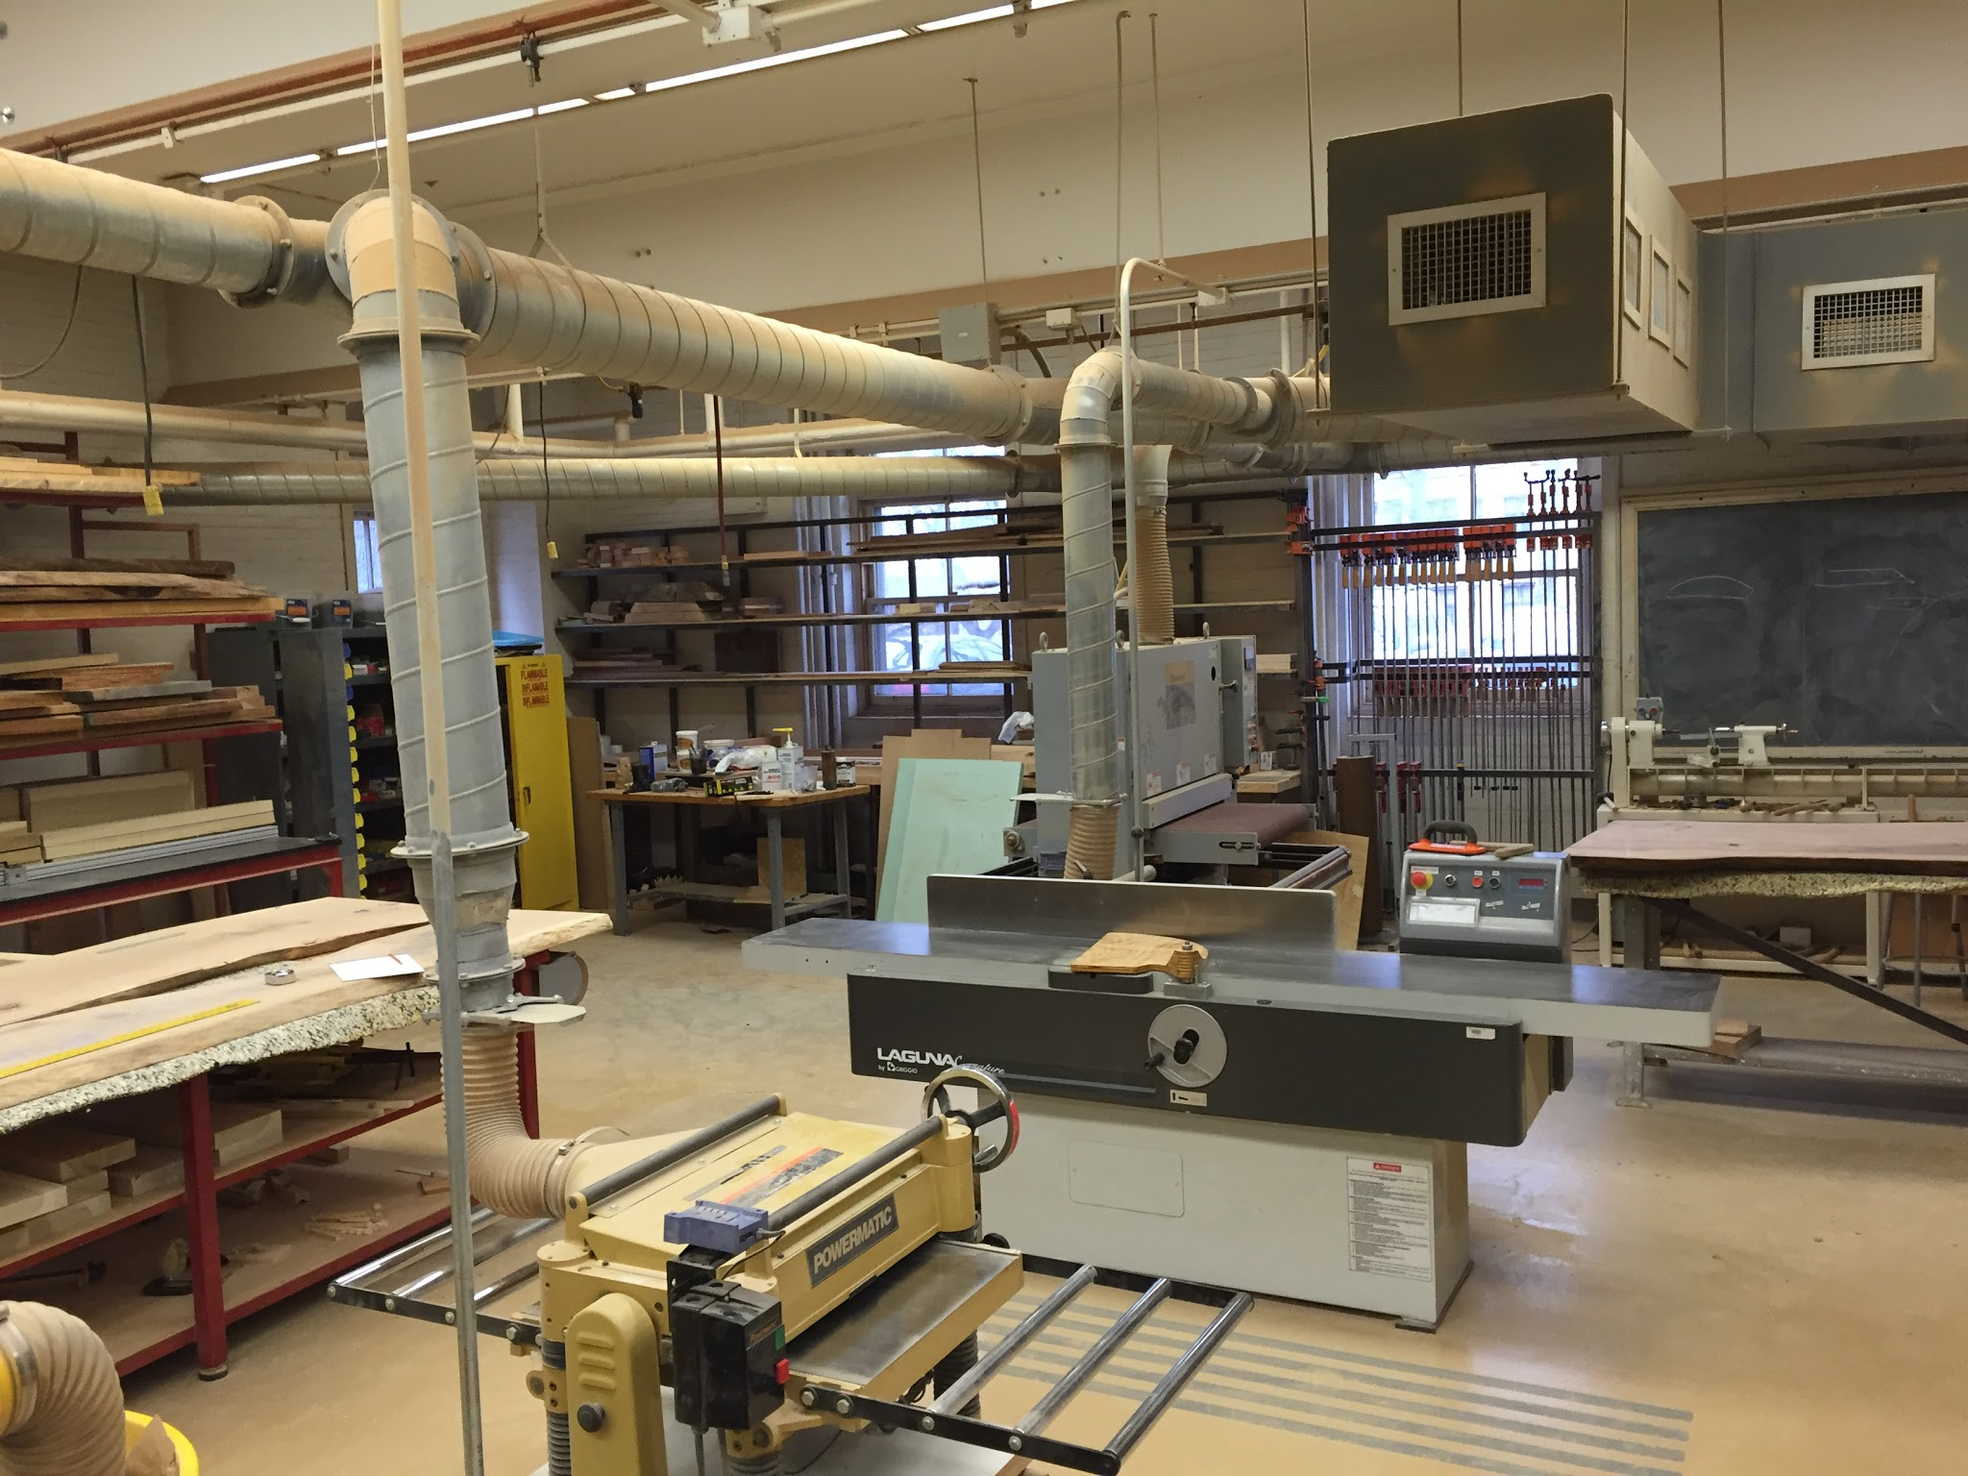
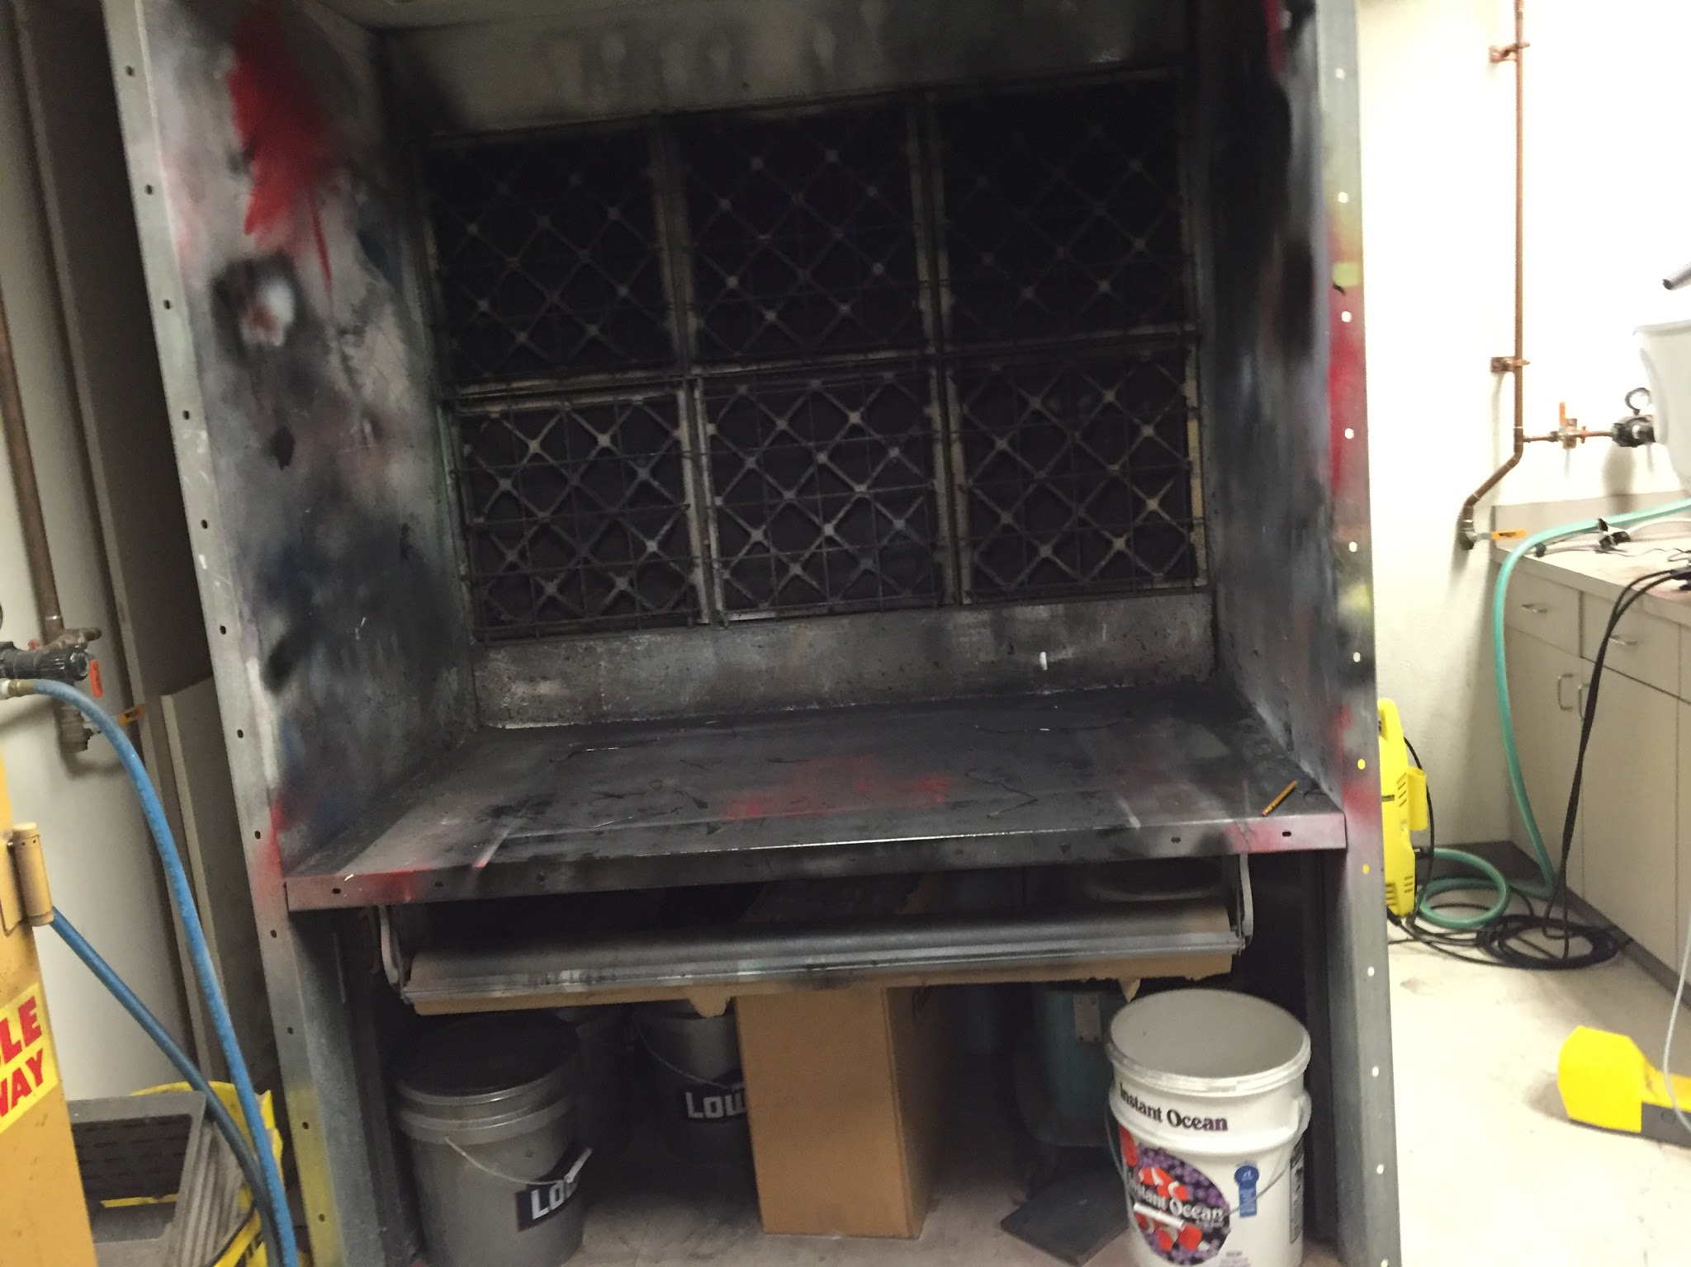
Prototyping - Capabilities
3D Printing
Woodshop
Spray Booth
Christian Davis

Slide 21

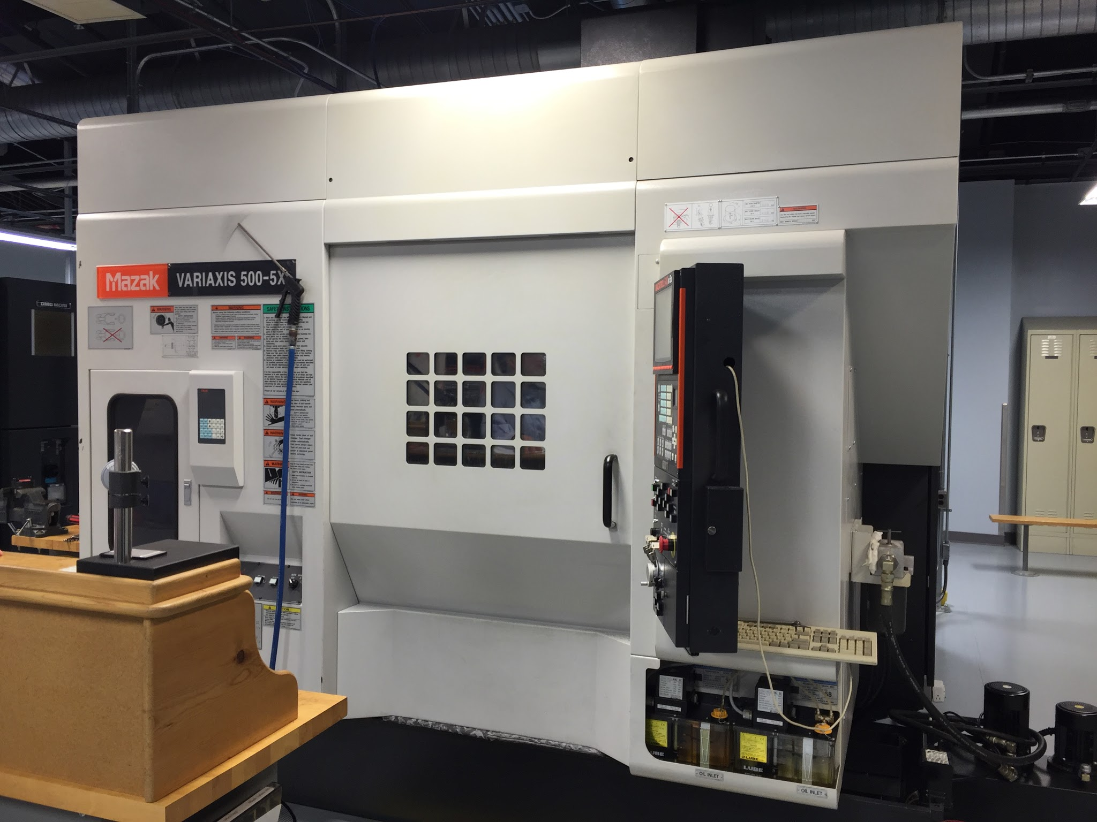
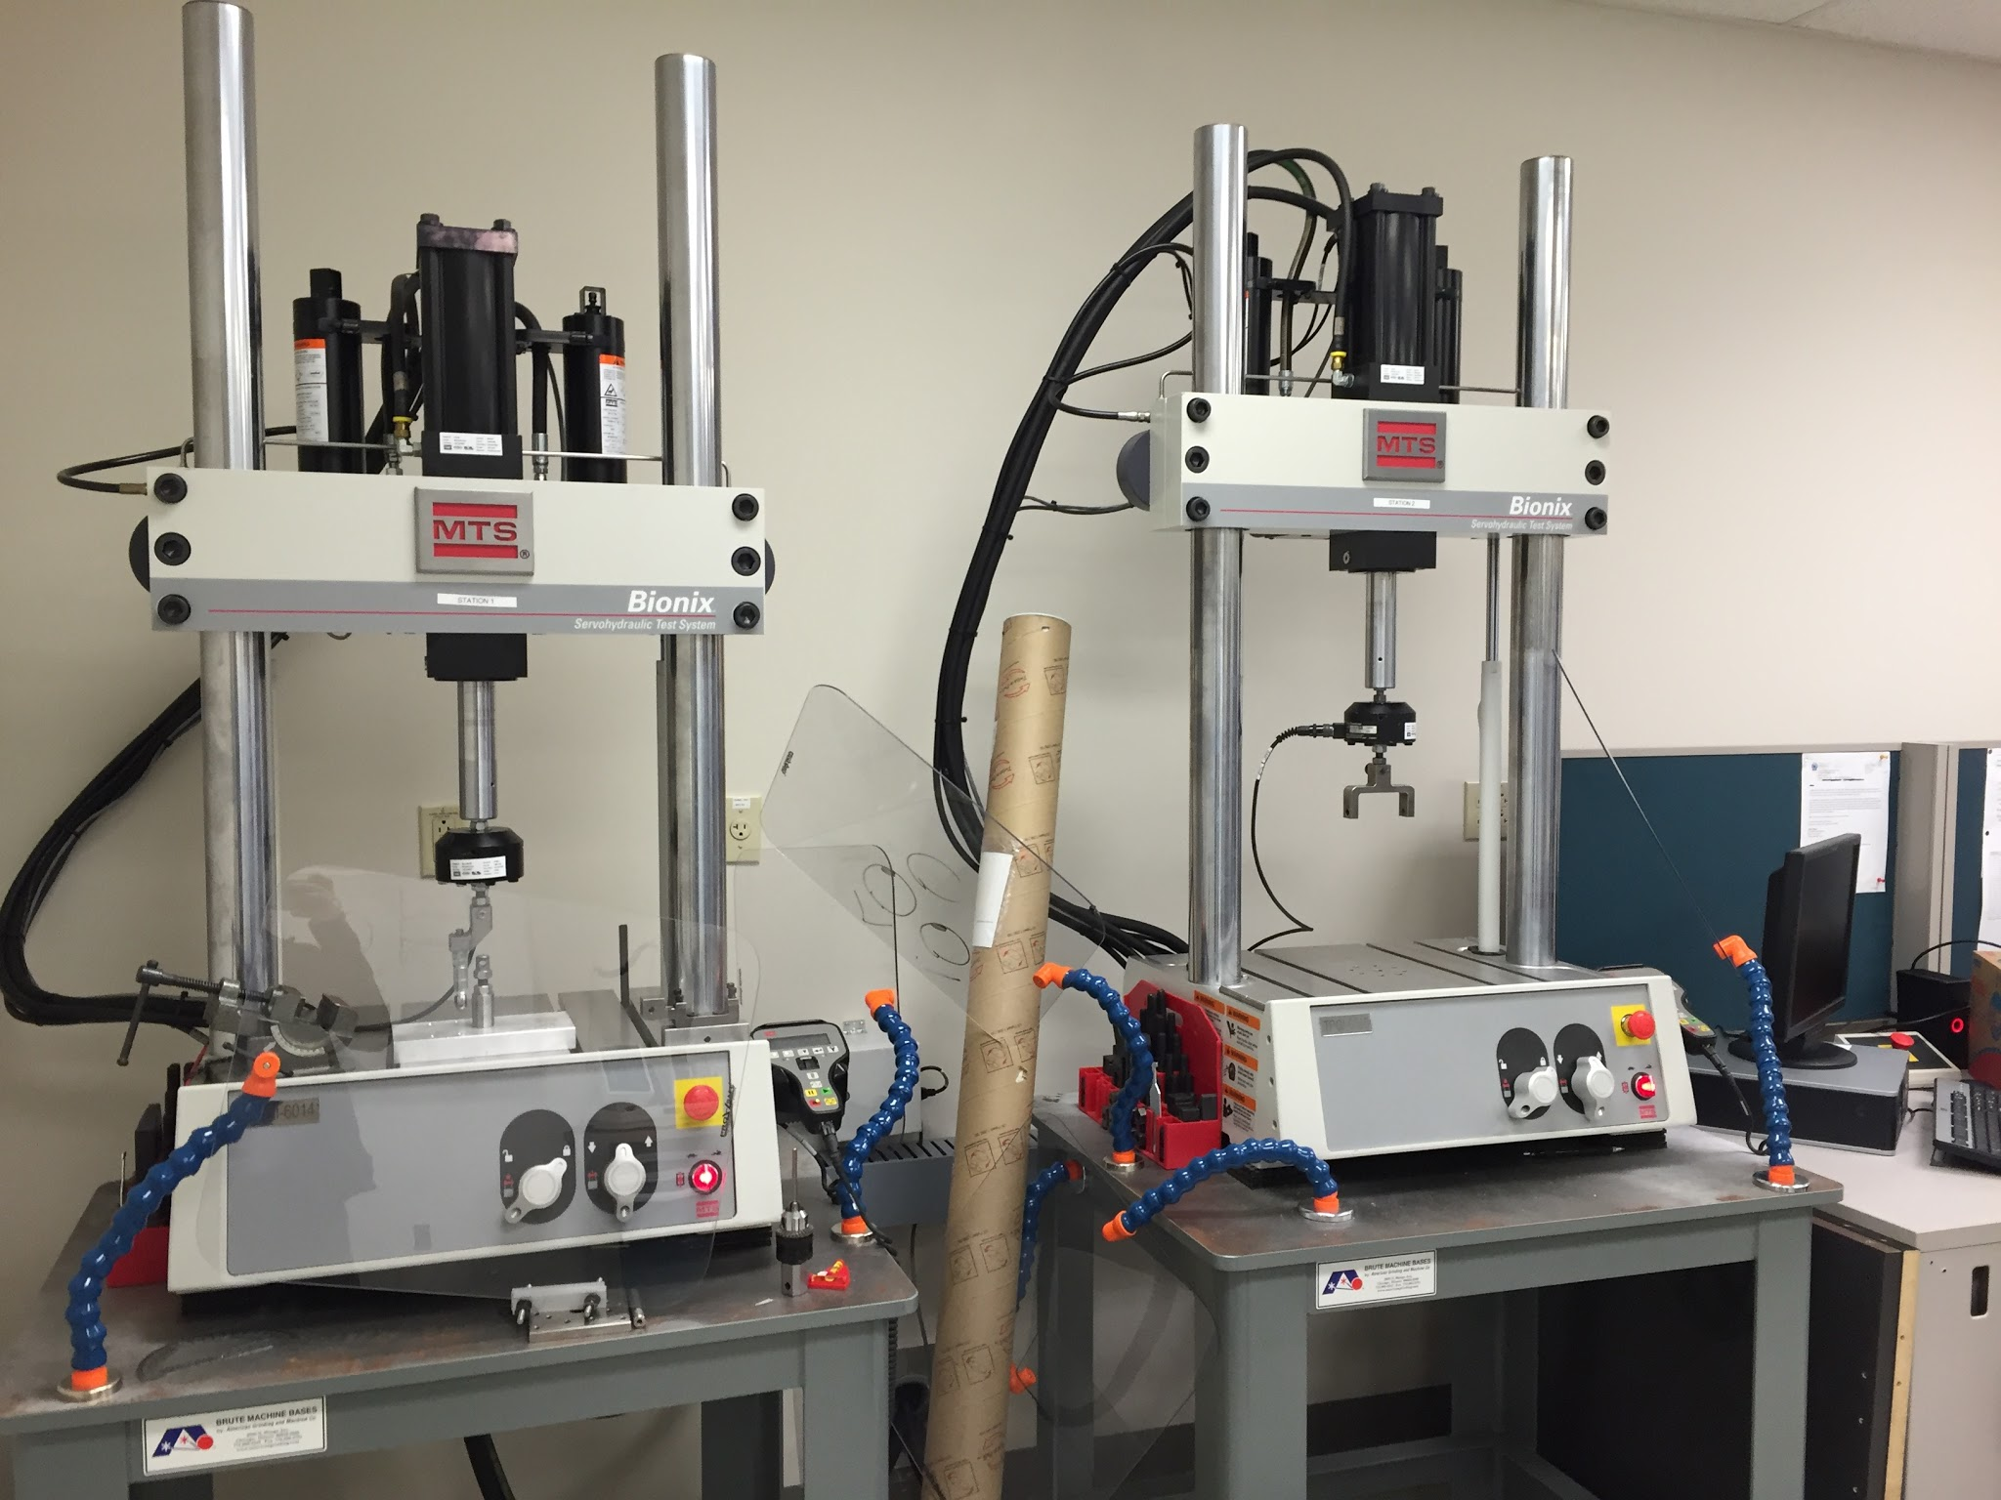
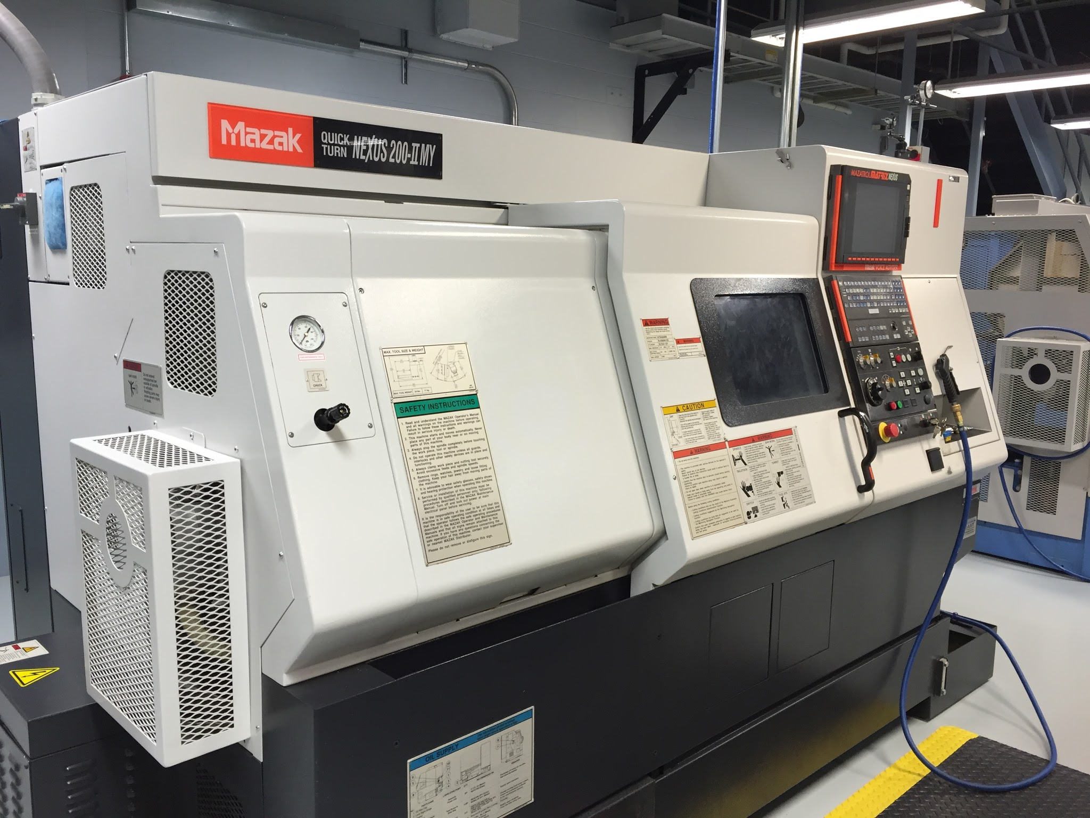
Prototyping - Capabilities
5 Axis Machining
Tensile Testing
Lathe
Christian Davis

Slide 22
Moving Forward
Continue concept designs
Develop concepts into mockups/prototypes using facilities at Lehigh and Aesculap
Setup and run mechanical testing on mockups/prototypes
Review results for potential improvements

Slide 23
Appendix A: Surgical Offices Contacted
St. Luke’s Neurosurgical Associates - Bethlehem
St. Luke’s Orthopaedic Specialists - Bethlehem
Coordinated Health - Emrick Boulevard
Coordinated Health - Schoenserville Road
Lehigh Valley Physician Group Neurosurgery - 1250 Cedar Crest
Lehigh Valley Physician Group Neurosurgery - Muhlenberg
Orthopaedic Associates of Allentown Orthopaedic Specialists
The Reading Neck and Spine Center
Cassie Christman

Slide 24
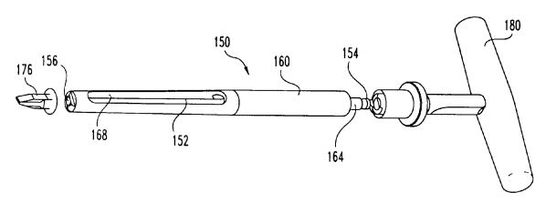
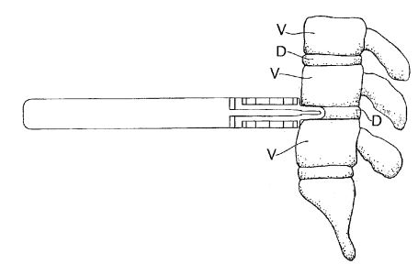
Appendix B: Intellectual Property - Wedge
US Pat #8,066,710
US Pat. #6,224,599
US Pat #8,105,331
Christian Davis

Slide 25
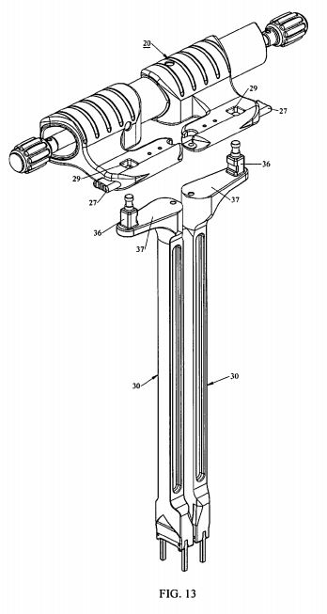
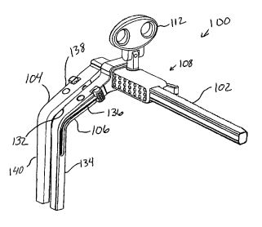
Appendix C: Intellectual Property - Parallel Crossbar
US Pat. #8,679,129
Christian Davis
US Pat. #9,241,700

Slide 26
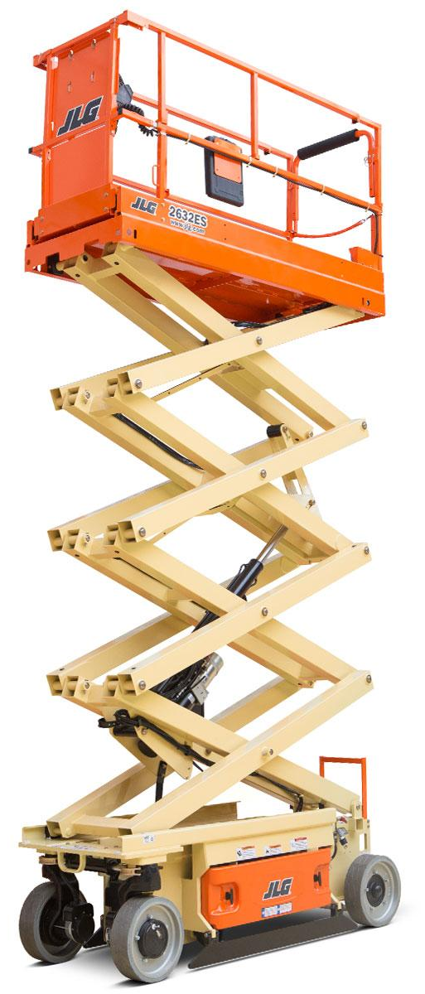
Appendix D: Intellectual Property - Scissor Lift
US Pat. #8,277,456
Christian Davis

Slide 27
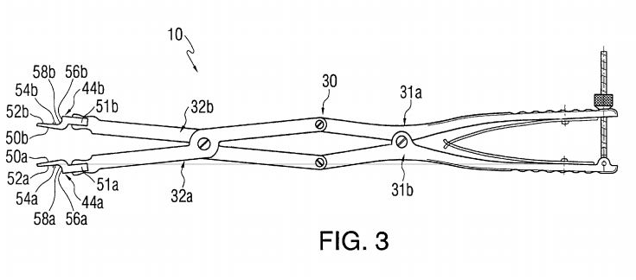
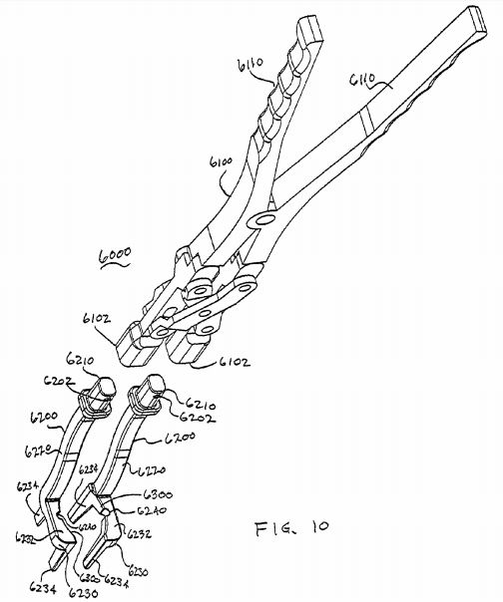
Appendix E: Intellectual Property - Hinged
US Pat. #6,261,296
US Pat. #9,132,020
Christian Davis

Slide 28
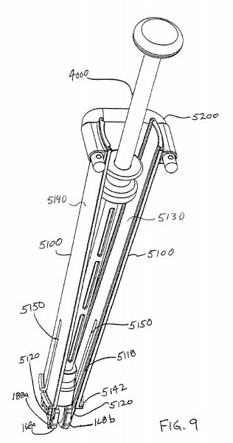
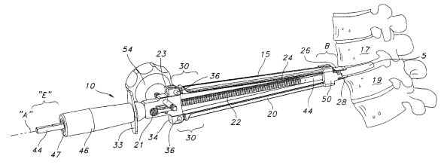
Appendix F: Intellectual Property - Tapered Blade
US Pat. #7,896,884
US Pat. #9,132,020
Christian Davis

